Slide 1


PHYSICS 192 LECTURE V. Instrument Control
Alexander De Los Reyes
National Institute of Physics
University of the Philippines Diliman

Slide 2
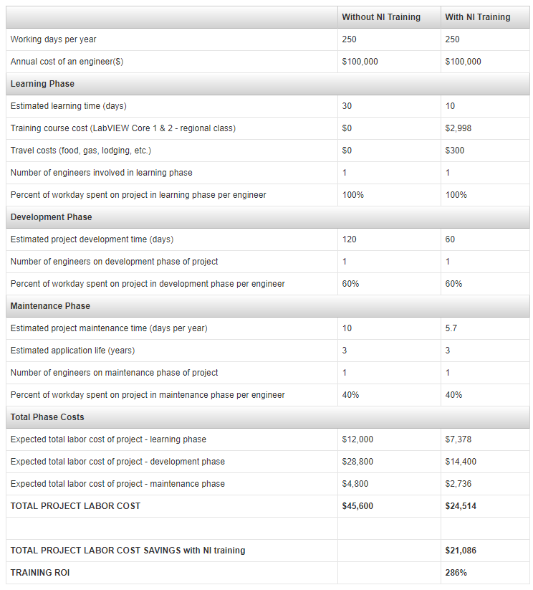

Slide 3
Acquiring Data
A data acquisition (DAQ) system uses a data acquisition device to pass a conditioned electrical signal to a computer for software analysis and data
logging.
You can choose a data acquisition device that uses a PCI bus, a PCI Express bus, a PXI bus, or the computer USB or IEEE 1394 port.
This lesson
explains the hardware used in a data acquisition system, how to configure the devices and how to program analog input and output, counters, and
digital input and output.

Slide 4
Acquiring Data
LabVIEW provides a graphical development environment with built-in functionality for configuring and controlling stand-alone instruments using a General Purpose Interface Bus (GPIB) or serial interface.
You can use LabVIEW to control and acquire data from instruments with the (1) instrument drivers , (2) Virtual Instrument Software Architecture (VISA) application programming interface (API), and (3) Instrument I/O Assistant, the, and.
At the end of this topic, you will be able to identify the key concepts related to instrument control of stand-alone instruments using a GPIB or serial interface.

Slide 5
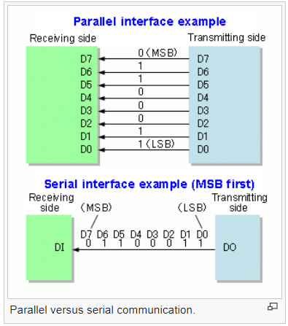
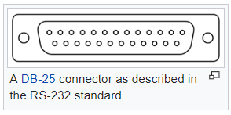
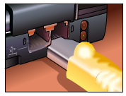
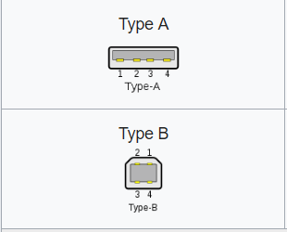
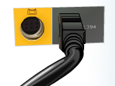
Acquiring Data
RS-232, USB, Firewire (Serial)

Slide 6
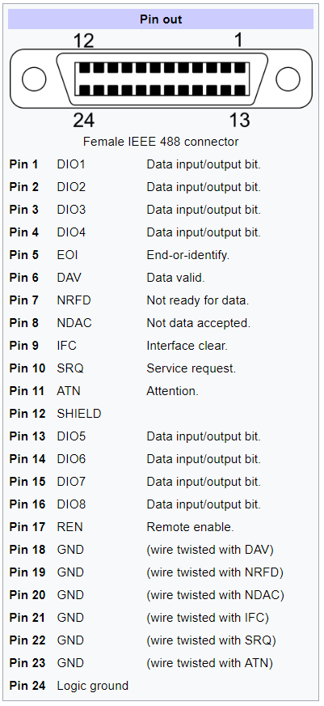
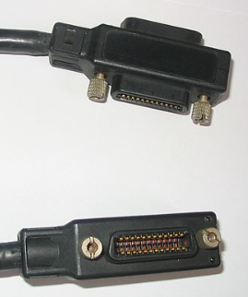
Acquiring Data
General Purpose Interface Bus (GPIB), also known as IEEE-488 (Parallel)

Slide 7
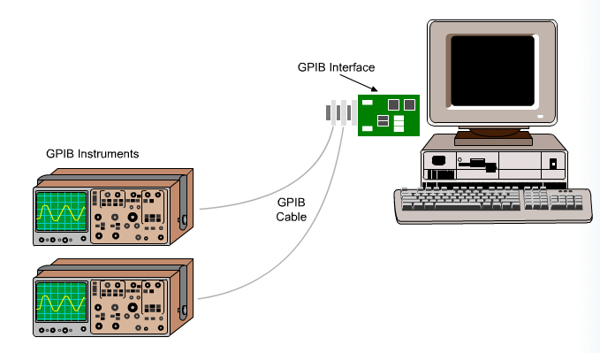
Acquiring Data
Using GPIB
GPIB, also called the ANSI/IEEE Standard 488.1-1987, describes a standard interface for communication between instruments and controllers from various vendors.
GPIB instruments offer test and manufacturing engineers the widest selection of vendors and instruments from general purpose to specialized vertical market test applications.
They are often used as stand-alone benchtop instruments where measurements are taken by hand.
You can automate these measurements by using a PC to control the GPIB instruments.

Slide 8
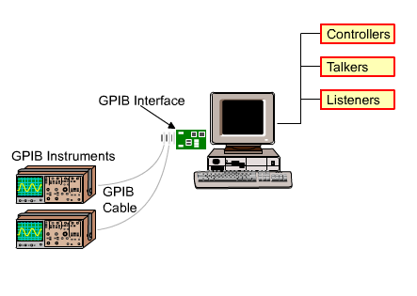
Acquiring Data
GPIB (Contd.)
GPIB is a digital, 8-bit parallel communication interface with data transfer rate of 1 MB per second and higher, using a three-wire handshake.
The bus supports one system controller, usually a computer, and up to 14 additional instruments.
The GPIB protocol categorizes devices as controllers, talkers, or listeners to determine which device has active control of the bus.

Slide 9
Acquiring Data
Serial vs Parallel
A parallel link transmits several streams of data simultaneously along multiple channels (e.g., wires, printed circuit tracks, or optical fibers).
A serial link transmits only a single stream of data.
Although a serial link may seem inferior to a parallel one, since it can transmit less data per clock cycle, it is often the case that serial links can be clocked considerably faster than parallel links in order to achieve a higher data rate.
A serial connection requires fewer interconnecting cables (e.g., wires/fibers) and hence occupies less space.
Crosstalk is less of an issue, because there are fewer conductors in proximity.
Serial is cheaper to implement than parallel. Many ICs have serial interfaces, as opposed to parallel ones, so that they have fewer pins and are therefore less expensive.

Slide 10
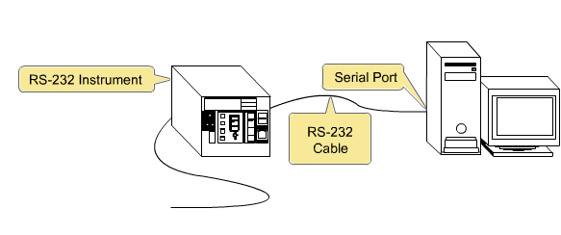
Acquiring Data
Using Serial Port Communication
Serial communication transmits data between a computer and a peripheral device, such as a programmable instrument or another computer.
Serial communication uses a transmitter to send data one bit at a time over a single communication line to a receiver.
You can use this method when data transfer rates are low or you must transfer data over long distances.
Most computers have one or more serial ports, so you do not need any extra hardware other than a cable to connect the instrument to the computer or to connect two computers to each other.

Slide 11
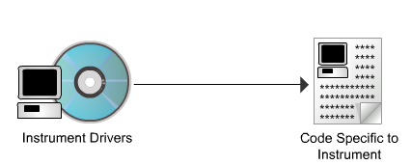
Using Instrument Drivers
When you use an instrument driver, the driver contains the code specific to the instrument.
Therefore, if you change instruments, you must replace only the instrument driver VIs with the instrument driver VIs for the new instrument, which greatly reduces your redevelopment time.

Slide 12
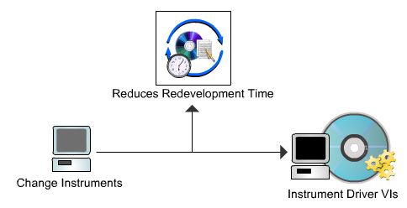
Using Instrument Drivers
Instrument drivers help make test applications easier to maintain because the drivers contain all the I/O for an instrument in one library, separate from other code.
When you upgrade hardware, upgrading the application is easier because the instrument driver contains all the code specific to that instrument.

Slide 13
Using Instrument Drivers
A LabVIEW Plug and Play instrument driver is a set of VIs that control a programmable instrument.
Each VI corresponds to an instrument operation, such as configuring, triggering, and reading measurements from the instrument.
The benefits of instrument drivers are listed on the screen.
Instrument drivers help users get started using instruments from a computer and saves them development time and cost because users do not need to learn the programming protocol for each instrument
With open-source, well documented instruments drivers, end users can customize their operation for better performance
A modular design makes the driver easier to customize.

Slide 14
Using Instrument Drivers
An instrument driver is a set of software routines that control a programmable instrument.
Each routine corresponds to a programmatic operation such as configuring, reading from, writing to, and triggering the instrument.
Instrument drivers simplify instrument control and reduce test program development time by eliminating the need to learn the programming protocol for each instrument.

Slide 15
Locating Instrument Drivers
You can locate most LabVIEW Plug and Play instrument drivers in the Instrument Driver Finder.
You can access the Instrument Driver Finder within LabVIEW by selecting Tools»Instrumentation»Find Instrument Drivers or Help»Find Instrument Drivers.
The Instrument Driver Finder connects you with ni.com to find instrument drivers.
When you install an instrument driver, an example program using the driver is added to the NI Example Finder.

Slide 16
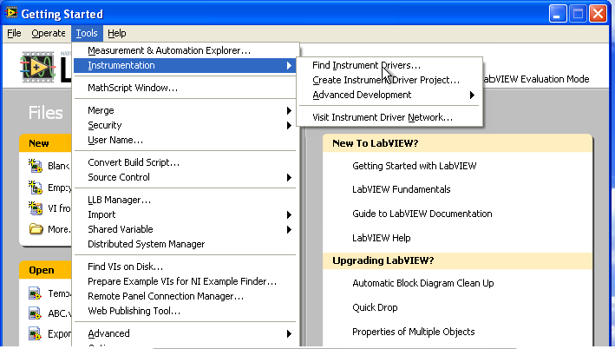
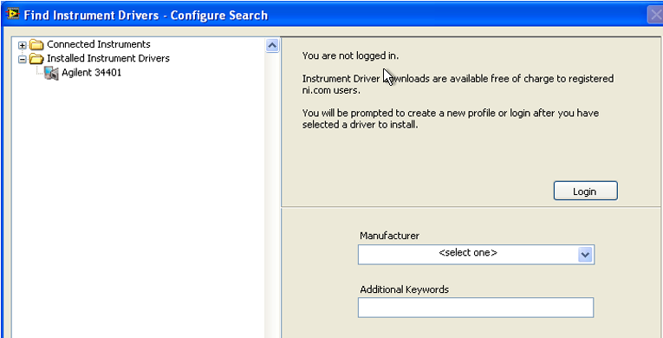
Locating Instrument Drivers

Slide 17
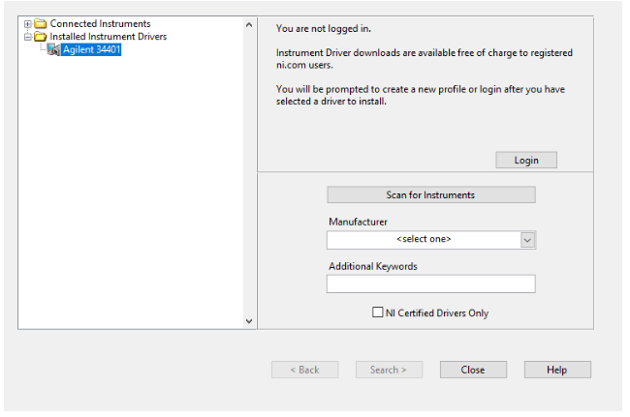
Locating Instrument Drivers

Slide 18
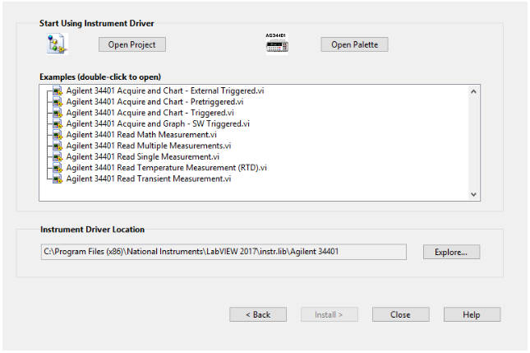
Locating Instrument Drivers

Slide 19
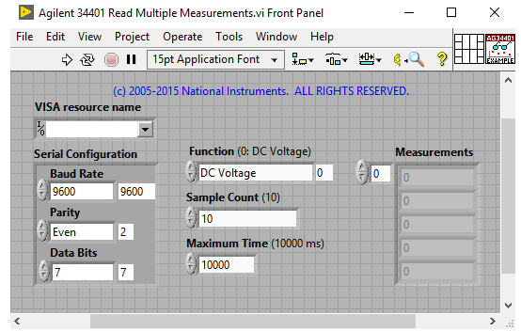
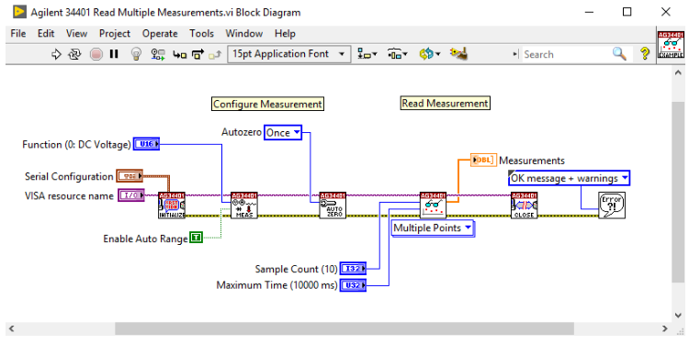
Locating Instrument Drivers

Slide 20
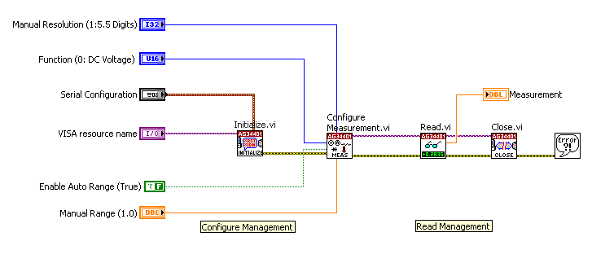
Example. Instrument Driver vI
The block diagram displayed on the screen initializes the Agilent 34401 digital multimeter (DMM), uses a configuration VI to choose the resolution and range, select the function, and enable or disable auto range, uses a data VIs to read a single measurement, closes the instrument, and checks the error status.
Every application that uses an instrument driver has a similar sequence of events: Initialize, Configure, Data, and Close.

Slide 21
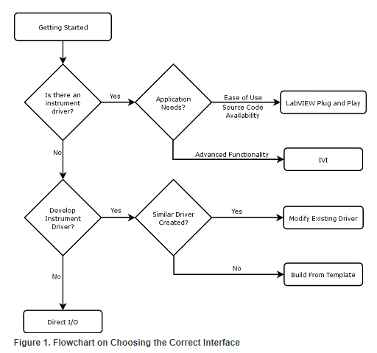
Flowchart

Slide 22
Acquiring Data
Serial Port Communication (Contd.)
You must specify four parameters for serial communication:
Baud Rate of the transmission – specifies how fast d,ata is sent over a serial line, in bits per second (1200,2400,4800,19200,38400,57600, and 115200)
Number of data bits – Data bits are transmitted upside down and backwards, which means that inverted logic is used and the order of transmission is from LSB to MSB.
Parity – is a simple, low level error checking. Can be none, even, or odd. The receiver calculates parity for the character and compares the result to the parity bit received. If the calculated and real parity bits don’t match, an error occurred and we act appropriately.
Stop bits – This bit tells us that the last character was just sent.

Slide 23
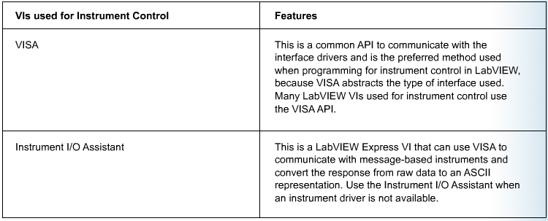
Acquiring Data
Software Architecture
The software architecture for instrument control using LabVIEW is similar to the architecture of data acquisition (DAQ).
Instrument interfaces such as GPIB include a set of drivers.
You can use Measurement and Automation Explorer (MAX) to configure the interface.

Slide 24
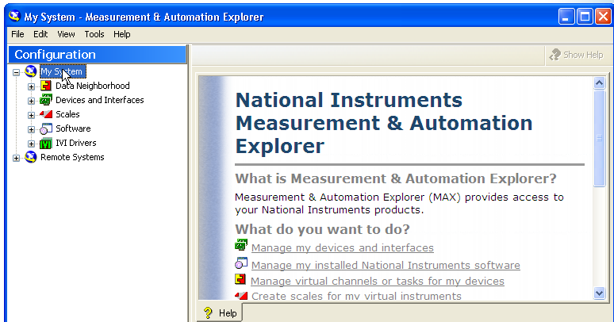
Measurement and automation explorer
You use MAX to configure and test the interface. To launch MAX, select Tools»Measurement & Automation Explorer in LabVIEW. Alternatively, you can double-click the MAX icon on the desktop to launch MAX. In MAX, you can list all the instruments connected to your PC by selecting the Scan For Instruments button on the toolbar. To configure the objects listed in MAX, right-click each item and select an option from the shortcut menu.

Slide 25
VISA
Using VISA
In LabVIEW, VISA is a single library of functions you use to communicate with GPIB, serial, VXI, and computer-based instruments. You do not need to use separate I/O palettes to program an instrument. VISA provides a single set of functions that work for any type of interface. Therefore, many LabVIEW instrument drivers use VISA as the I/O language. Features of VISA are listed below.
VISA is the lower layer of funcitons in the LabVIEW Instrument Driver. Vis that communicates with the driver software.
VISA by itself does not provide instrumentation programming capability
VISA is a high level API that calls low-level drivers

Slide 26
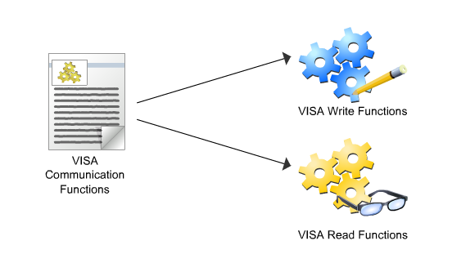
VISA Communication Functions
If you choose not to use the Instrument I/O Assistant to automatically generate code for you, you can still write a VI to communicate with the instrument.
The most commonly used VISA communication functions are the VISA Write and VISA Read functions.
Most instruments require you to send information in the form of a command or query before you can read information back from the instrument.
Therefore, the VISA Write function is usually followed by a VISA Read function.

Slide 27
VISA and Serial
The VISA Configure Serial Port VI uses the following:
VISA Resource Name – initializes the port identified by VISA resource name to the specified settings
Timeout – sets the timeout value for the serial communication
Baud rate, data bits, parity, and flow control specify those specific serial port parameters
Error in and error out – maintain error conditions for the VI

Slide 28
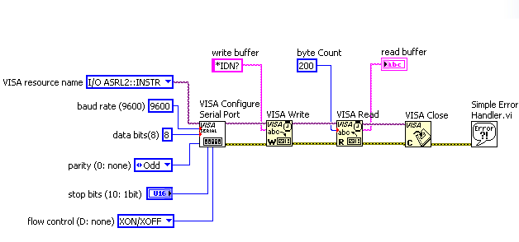
VISA and Serial. Example

Slide 29
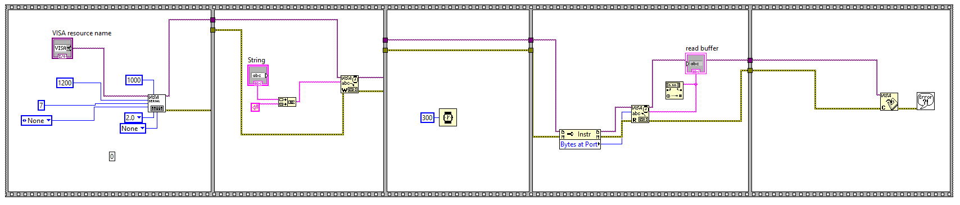
VISA and Serial. Example
Programming an AFG-2000 Arbitrary Function Generator

Slide 30
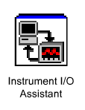
Instrument I/O Assistant
The Instrument I/O Assistant is a LabVIEW Express VI that is used when an instrument driver is not available. It is used to:
Communicate with message-based instruments.
Can also be used to a serial, Ethernet, or GPIB interface
Convert the raw data to an ASCII representation
Organize instrument communication into ordered steps

Slide 31
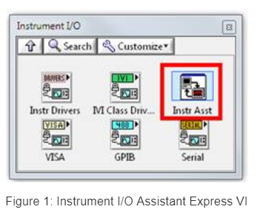
How to use Instrument I/O Assistant

Slide 32
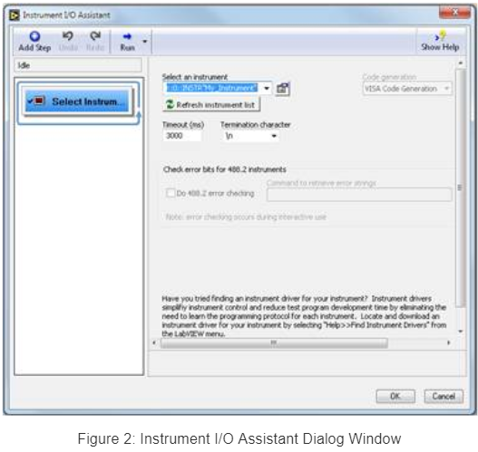
How to use Instrument I/O Assistant

Slide 33
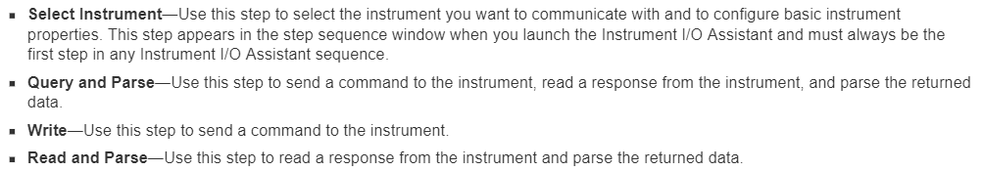
How to use Instrument I/O Assistant

Slide 34
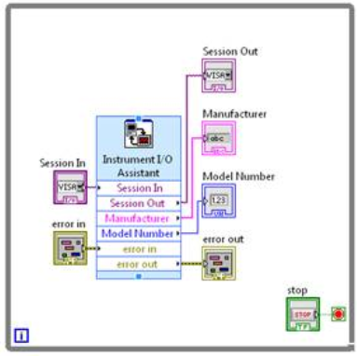
How to use Instrument I/O Assistant

Slide 35
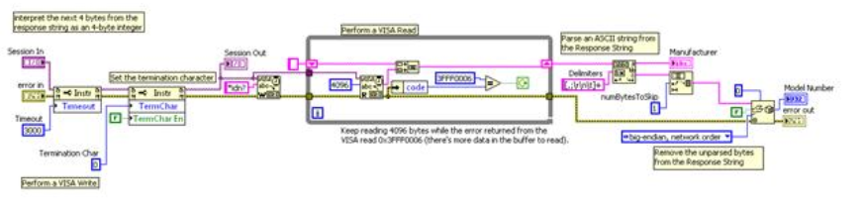
How to use Instrument I/O Assistant

Slide 36
ANNOUNCEMENT
LabVIEW written exam on 24 April 2019
Bring one bluebook as your answer sheet.

